Slide 1
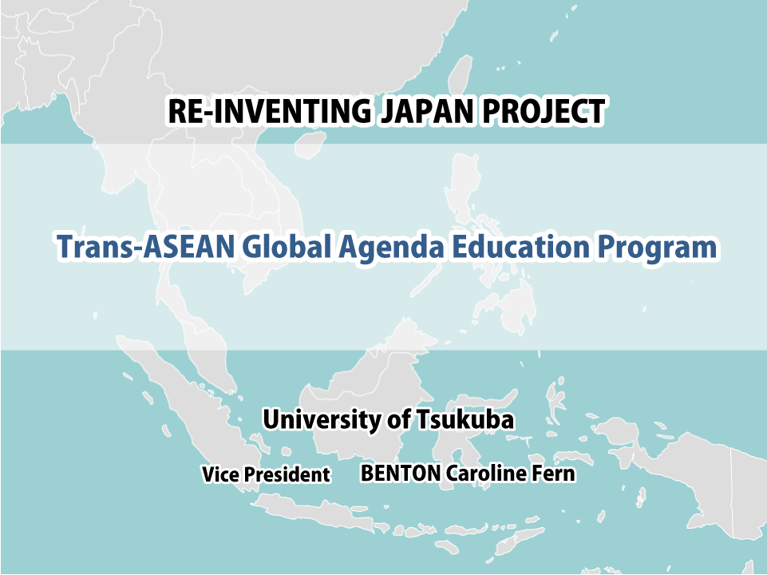
アセアン横断型グローバル課題
挑戦的教育プログラム
大学の世界展開力強化事業
University of Tsukuba International Activities and AIMS Program
Trans-ASEAN Global Agenda
Education Program
筑 波 大 学
構 想 責 任 者
国際担当副学長 ベントン・キャロライン・ファーン
教育企画室長 佐藤 忍

Slide 2
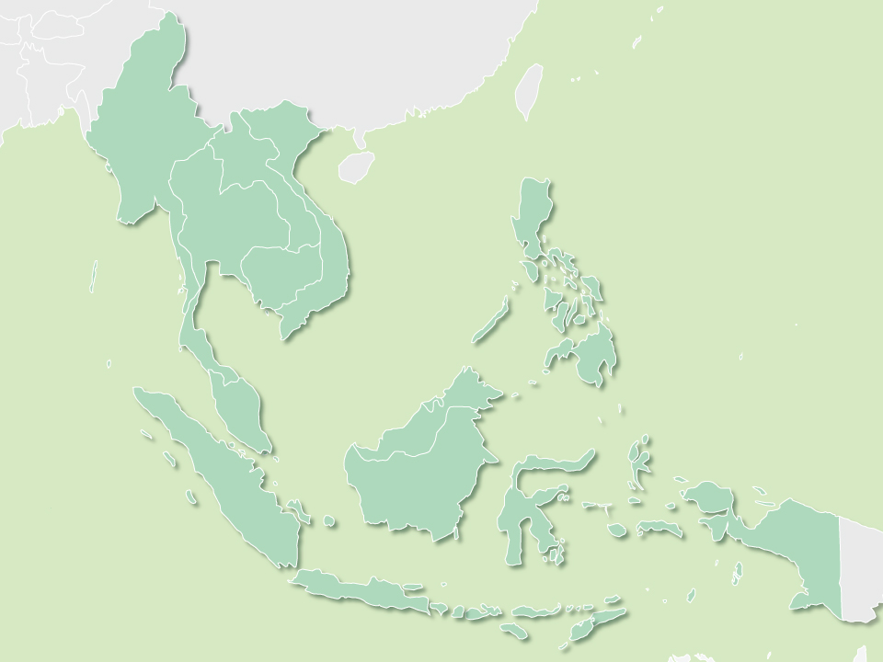






Trans-ASEAN Global Agenda Education Program
Program Concept and Promotion System ①
1
Founding principle：「University open to the world」
Mission： Development of knowledge and human resources vital for solving global challenges
Trans-ASEAN Global Agenda Education Program
・ interdisciplinary and internationally-minded
・ courses in English offered for 7 target fields of study
・ HR training to achieve MDGs in collaboration with UNU
・ internationally compatible undergraduate education
Global agendas proposed by UN
<MDGs・SDGs>
Traits vital for solving global challenges
global mindset
understanding of global challenges
expertise
intercultural understanding
communication ability
Eradication of poverty
Water, energy, health, agriculture and biodiversity
Sustainability, green growth, disaster prevention
Achieve
in ASEAN
Increase in student mobility
Int’lization of ASEAN universities
Networks of young professionals
Expansion of AIMS Programme
HRD through education programs
From ASEAN to the world
Collaboration with
domestic and int’l
organizations

Slide 3
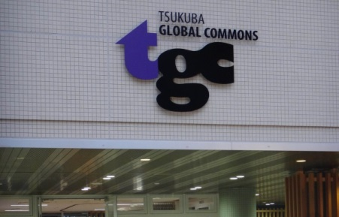
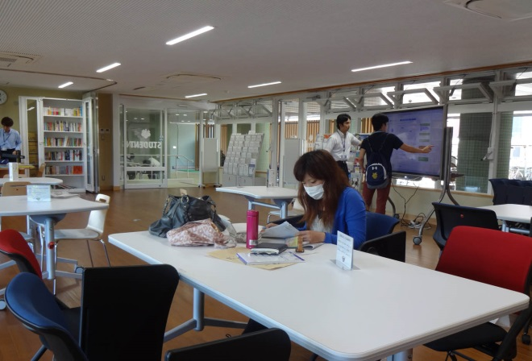
Trans-ASEAN Global Agenda Education Program
Program Concept and Promotion System ②
2
University open to the world
Int’lization in everyday life
ＡＩＭＳ
・Rapid increase
in student
mobility
・Stronger
partnership with
ASEAN members
and SEAMEO
・AIMS
Programme
expansion
through joint
research projects
Global Commons
・One stop service for int’l students
・Promotion of staff int’lization
・Promotion of study abroad programs among Japanese students
Ｇ３０
・Undergraduate degree programs taught in English
・Int’l recruiting
of teaching staff
・Campus
globalization
ＣＲＩＣＥＤ
（Center for Research on Int’l Cooperation in Educational Development)
・SEAMEO
partner since
2009
ＪＴＰ courses
・More than 400
courses offered
in English for
short term
exchange
students
1995
2002
2009
2012
2013

Slide 4

3
Trans-ASEAN Global Agenda Education Program
Quality Assurance System
Steering Committee
Joint Committee with partners
Chairperson ： Vice President (Education)
Vice-chairperson: Vice President (Int’l Affairs)
Off. of Educational Planning Dept. of Educational Promotion
Off. of Int’l Strategy Dept. of Global Activities
CRICED ⁺ Int’l Student Center (ISC)
University of Tsukuba
Partner University
Undergrad. Schools
Dept. of Global Activities
Global Commons
ISC
Program faculty
Administrative staff
in charge of int’l
affairs
Outbound Exchange Subcommittee
Global Commons
Org. of Liberal Arts Education
Undergrad. Schools
Inbound Exchange Subcommittee
Global Commons
ISC
Undergrad. Schools
Relevant offices
SEAMEO
-RIHED
Joint research
CRICED⁺
・Grade evaluation, credit transfer standards
・Student selection standards
・Student support
・Returnee network
・Adjustment of school year calender
・Quality of education and course evaluation standards
・Program curriculum
・Student support
・PR, summer program implementation
External Evaluation Committee
SEAMEO-RIHED
United Nations University
Cornell University
・Consistency with MDGs and SDGs
・Evaluation of HRD goals
・Contribution to ESD
・Verification of quality of education and grade
evaluation standards

Slide 5
Trans-ASEAN Global Agenda Education Program
Human Resource Development (Curriculum)
4
Inbound （25 students per year)
Outbound （25 students per year）
JTP courses・ G30 courses taught in English
From 7 fields at partner universities
Over 400 courses
Lib. arts
UN
MDGs
Eradication of poverty
Water
Energy
Health
Agriculture
Biodiversity
Sustainability
Green growth
Disaster prevention
Intercultural understanding
16
～
20
credits
Liberal arts courses （general foundation subjects）
Art・Japanese language and culture・PE etc.
Major
Expertise
Intercultural understanding
12
credits
Internship
Major subjects, foundation subjects for major
=>Courses on health, environment etc.
Understanding of global challenges
Expertise
Special courses （with ASEAN students）
▪ Communication ability
▪ Understanding of
global challenges
2
credits
Special courses
▪ Communication ability
▪ Understanding of
global challenges
Introduction to Global Society （1 credit）
・Lectures held by experts from UNU, the
government, and industry
Trans-ASEAN Global Debate Seminar （1 credit）
・debate with students and faculty from each
program participant country
Major Seminar I～VI （1 credit each）
・Outdoor training at Shimoda Marine Research
Center and other locations
Global Internship （1 credit each）
・Internships at companies and research institutes
focused on global challenges
Introduction to Global Society
Trans-ASEAN Global Debate Seminar
Global courses (by Global Commons)
6
credits
Practical language
Education courses
Communication ability
Potential partner universities （22)
AIMS members （17）
Malaysia：4
Indonesia：3
Thailand：5
Vietnam：1
Philippines：4
Others （5）
Australia：2
Myanmar：1
Cambodia：1
Laos：1
Achieve in
ASEAN

Slide 6

Trans-ASEAN Global Agenda Education Program
Human Resource Development (Schedule)
5
Inbound
◎Presentations
of research
done abroad
◎Japanese language and
culture courses through
distance learning
◎Domestic
support
◎Guidance
◎Certificate of
completion conferral
Briefing on life
In Japan and at UT
Pre-arrival stage
Study in Japan
Follow-up upon return
◎Short-term study in
Japan, summer school
◎Credit transfer
procedure
◎Preparing study plans based on UT courses
Outbound
◎Motivate freshmen to
study abroad
◎Language check
◎Presentations of research done abroad
◎Summer programs abroad
◎Education on life and safety abroad
◎Certificate of completion conferral
Motivating,
Improving
communication
Study abroad
Follow-up upon return
Pre-travel (1st~2nd year）
（2nd~3rd year）
（3rd~4th year）
◎Improve language proficiency
◎Collaborative study (lectures,
debates) with int’l students
◎Overseas
support
（overseas
offices）
◎Tutoring of inbound int’l students
◎Coursework confirmation,
creation of study plans
◎Coursework check, credit transfer

Slide 7
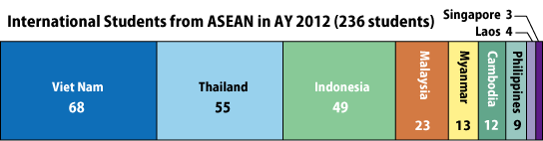
Trans-ASEAN Global Agenda Education Program
Previous accomplishments in student exchange
6
Undergrad. Study abroad programs (1 semester～)
Motivating short-term programs (1month or less)
「Junior Year at Tsukuba Program」
（1995～, JASSO, inbound students： 873）
「 Internship program for Agriculture & Environment 」
（2007～, JASSO, bilateral, participant：340）
「Promotion of Int’l Student Admission through Undergraduate Degree Programs Taught in English」
（2009～、Ｇ30 Program, inbound students： 143）
「Bioresource Science Student Forum」
（2011, inbound exchange, participants：18）
「Brazilian Government Sponsored Scholarship Program
“Science without Borders (Ciencia sem Fronteiras)”」
（2013～, inbound students：9）
「Overseas Graduation Research Presentation for Bioresource Science Students」（2012, outbound, participants：10）
「AsOBiNet （Asia Oceania Biology student Network）」
（2007～, bilateral, participants：107）
「International Student Exchange Program for Sustainable Development of Bioresources in Indochina」
（2011, JASSO , JENESYS Program, inbound students：12）
「Cosmos Chat Cafe, City Chat Cafe」
（2009～, int’l exchange, participants：approx.300）
「School of Life and Environmental Sciences Student Exchange Program」
（2011～, JASSO, inbound students：35）

Slide 8
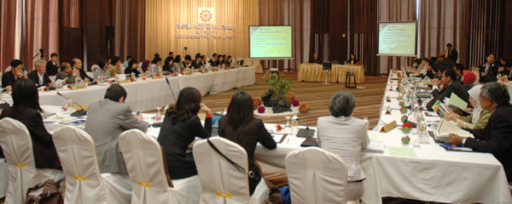

Trans-ASEAN Global Agenda Education Program
SEAMEO and Educational Development
7
CRICED is
the only SEAMEO partner in Japan
developing best practice approaches among other AIMS program universities
jointly organizing Int’l Symposia on Educational Development with SEAMEO
Program improvement and expansion
Joint research with SEAMEO
accepted long-term researcher from SEAMEO-RIHED
participation to the SEAMEO Centre Directors Meeting
joint research and int’l conferences on globalization of higher education with SEAMEO-RIHED
UT at SEAMEO meeting
5th UT, CRICED-SEAMEO Int’l Symposium, Theme 「Expansion Strategy and University Association」
Creating best practice approaches
Developing indicators for improved evaluation
4th UT, CRICED-SEAMEO Int’l Symposium
Theme 「AIMS Programme Expansion Strategy」
3rd UT, CRICED-SEAMEO International Symposium
Theme 「Formulation of evaluation standards」
Spreading
research
results
Japan in AIMS
2nd UT, CRICED-SEAMEO International Symposium
Theme 「AIMS Programme in practice」
1st UT, CRICED-SEAMEO International Symposium
Theme 「Necessity, Concepts, and
Vision for Mobility Programs」
Contribute to
ACTFA
Expand the
AIMS Programme

Slide 9

8
Trans-ASEAN Global Agenda Education Program
Expected outcome of set objectives
Trans-ASEAN Global Agenda Education Program
Human resource development
Dissemination of results
Employment at
global companies
Joint program implementation with other domestic universities
Global leaders at
UN organizations
and int’l NGOs
AIMS Programme expansion by joint research with SEAMEO
ASEAN-Japan Young Professionals Network
Contribution to ACTFA(Academic Credit
Transfer Framework for Asia)
Global expansion of ASEAN success

